Slide 1

Using Python Visuals in Power BI
March 2022

Slide 2
Prerequisites
Install Python- To run Python scripts in Power BI Desktop, you need to install Python on your local machine. You can download Python from https://www.python.org/
Install required Python packages- The Power BI Python integration requires the installation of two Python packages:
Pandas- A software library for data manipulation and analysis. It offers data structures and operations for manipulating numerical tables and time series.
Matplotlib- A plotting library for Python and its numerical mathematics extension NumPy.
Enable Python scripting-
To enable Python scripting:
In Power BI Desktop, select File > Options and settings > Options > Python scripting. The Python script options page appears.
If necessary, specify your local Python installation path in Detected Python home directories.
Make sure the path is for the local Python installation.
3. Select OK.
Once you specify your Python installation, you’re ready to begin running Python scripts in Power BI Desktop.

Slide 3
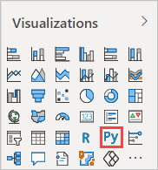
Steps
1. Select the Python visual icon in the Visualizations pane.
2. In the Enable script visuals dialog box that appears, select Enable.
When you add a Python visual to a report, Power BI Desktop takes the following actions:
A placeholder Python visual image appears on the report canvas.
The Python script editor appears along the bottom of the center pane.

Slide 4
Steps (Contd.)
3. Next, drag the required fields into Add data fields here section.
Your Python script can only use fields added to the Values section. You can add or remove fields from the Values section while working on your Python script.
4. Now you can use the data you selected to create a plot.

Slide 5
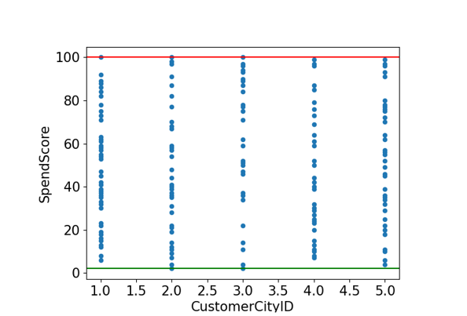
import matplotlib.pyplot as plt
import seaborn as sns
dataset.plot(kind='scatter',x='CustomerCityID',y='SpendScore',fontsize=15)
plt.xlabel('CustomerCityID',fontsize=15,color='black')
plt.ylabel('SpendScore',fontsize=15,color='black')
min,max = dataset['SpendScore'].min().astype(int),dataset['SpendScore'].max().astype(int)
plt.axhline(y=min, color='g', linestyle='-')
plt.axhline(y=max, color='r', linestyle='-')
plt.show()

Slide 6
References
https://docs.microsoft.com/en-us/power-bi/connect-data/desktop-python-scripts
https://docs.microsoft.com/en-us/power-bi/connect-data/desktop-python-visuals

Slide 7
Thank You

